Slide 1
Header
Well A
Pipeline
Well B

Slide 2
1
Header
Well A
Pipeline
3
Well B
2
flow measurement
1 | Well A flow line pressure
2 | Well B flow line pressure
3 | total oil production rate
facility parameter

Slide 3
Header
Well A
1
Pipeline
3
Well B
2
flow measurement
1 | Well A flow line pressure
2 | Well B flow line pressure
3 | total oil production rate
facility parameter

Slide 4
A
1
C
1
2
3
5
B
2
4
3
flow measurement
1 | Well A flow line pressure
2 | Well B flow line pressure
3 | total oil production rate
facility parameter
port

Slide 5
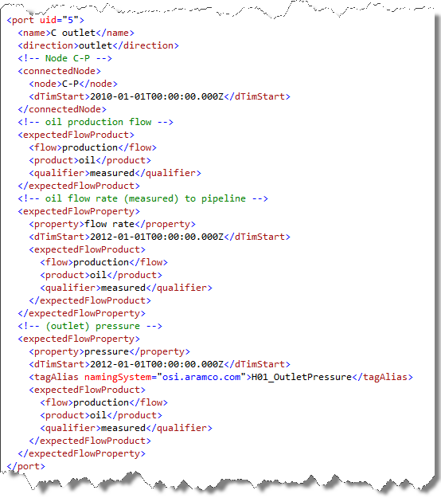

Slide 6
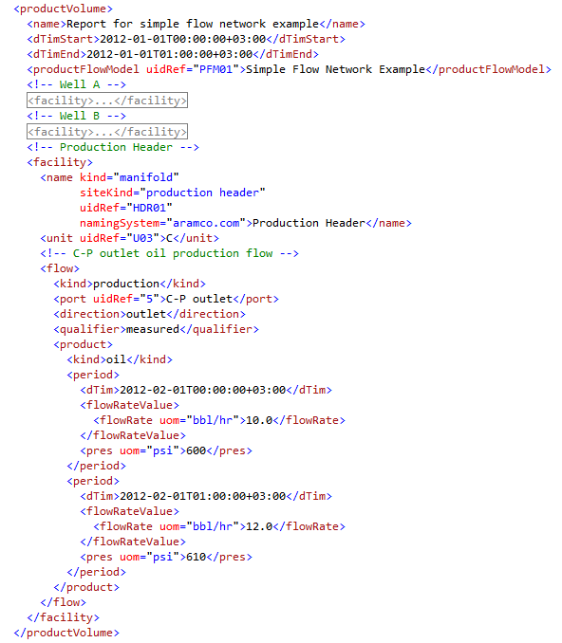
Unit Reference
Port Reference
Flow rate and pressure at a specified time

